Slide 1

Project 1: Andrew Middleton Scott Kutlick

Slide 2

AGENDA
Project Proposal
Data Analysis
decision
FINAL Comments & TAKEAWAYS

Slide 3

Major Motion Picture Investment

Slide 4
Project Proposal
Major Motion Picture Investment

Slide 5

Project Proposal
Mutual interest in movies and film as entertainment, as well as a future career path
Dataset: Top 10 Highest Grossing Films (1975-2018) (kaggle.com)

Slide 6
What Kind of Movie to make and which Studio to partner with in order make the most money?
Film Attributes:
Does an animated or live-action movie generate more worldwide gross income?
What MPAA rating hits the “sweet spot” for attracting the largest audiences?
What genre and / or sub-genres should we target?
Does the length of a movie matter to the overall gross income?
Studio / Distributor Attributes:
Do certain production companies focus primarily on specific genres?
On average, which studios tend to generate higher gross income at the box office?
Which distributors tend to put out higher quality films?
Is there correlation between the IMDb rating of a movie and the gross income?

Slide 7
Data Analysis
Major Motion Picture Investment

Slide 8
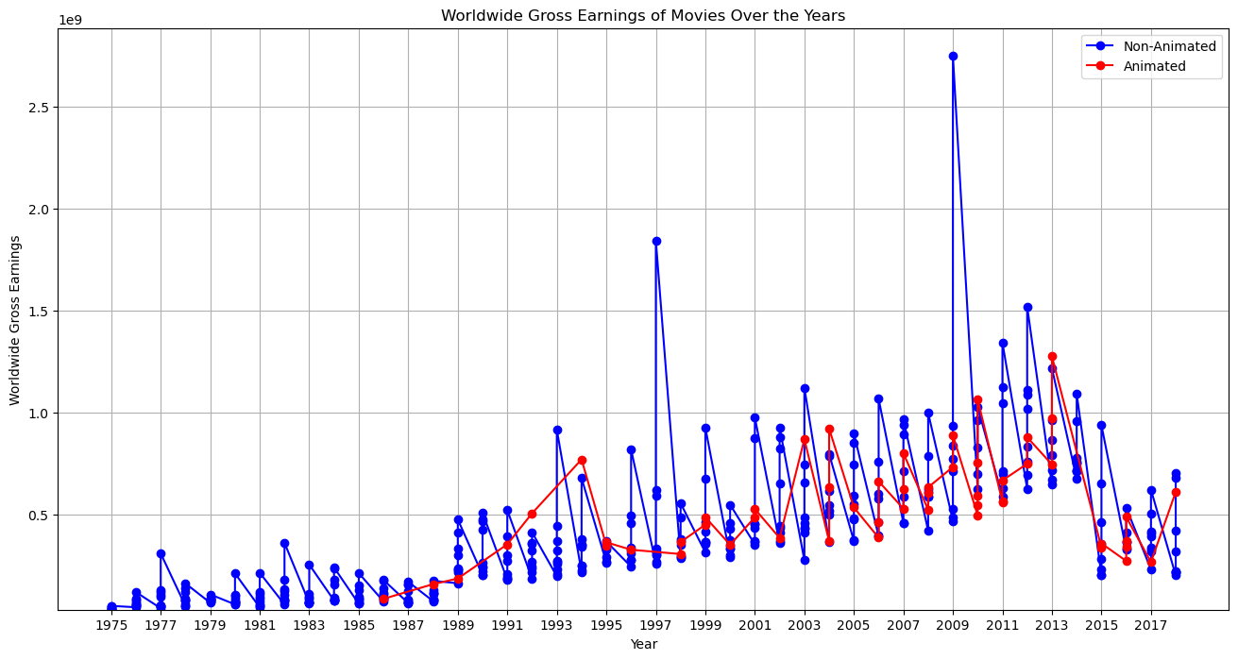
What type of film should we make? Animated vs. Non-AnimateD

Slide 9
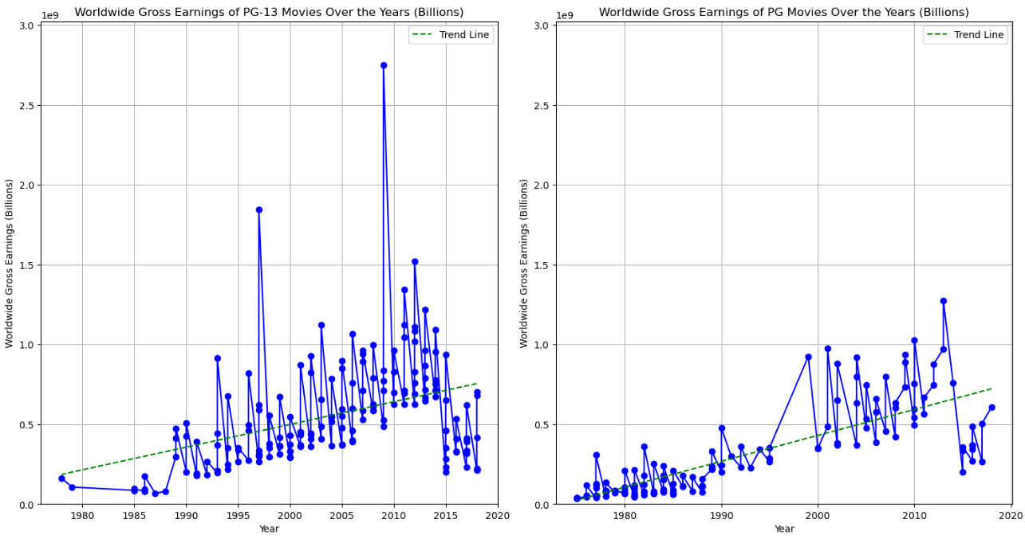
What MPAA Rating should we target? PG-13 & PG

Slide 10
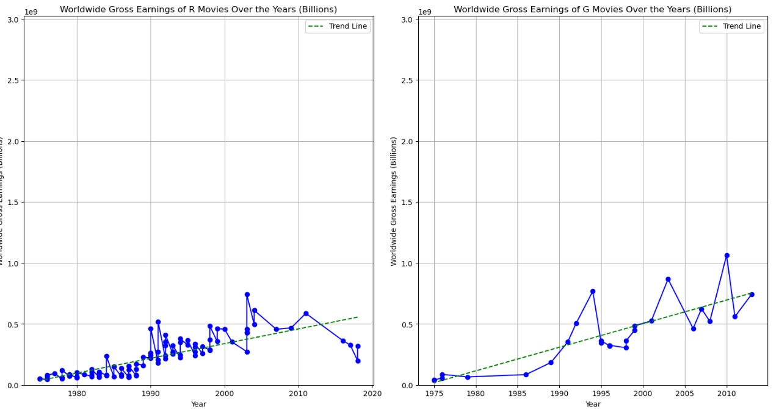
What MPAA Rating should we target? R & G

Slide 11
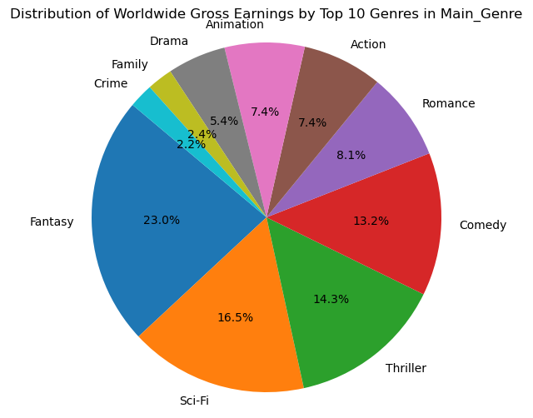
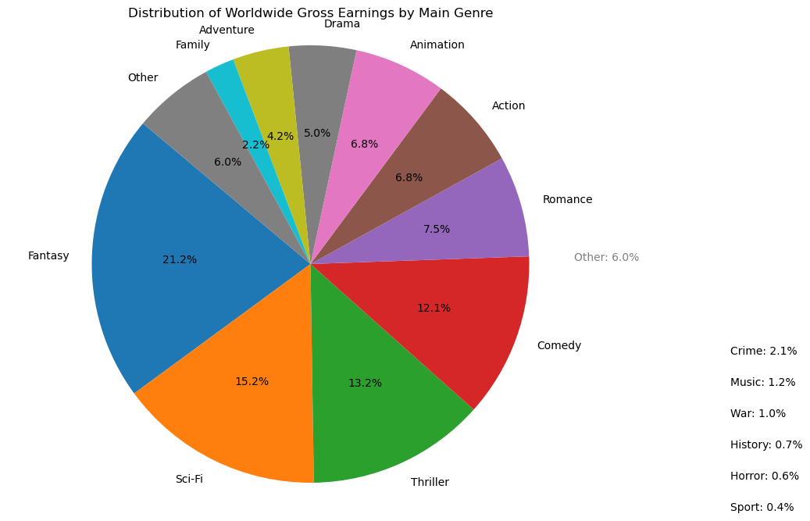
Which Genres have highest Worldwide Gross?

Slide 12
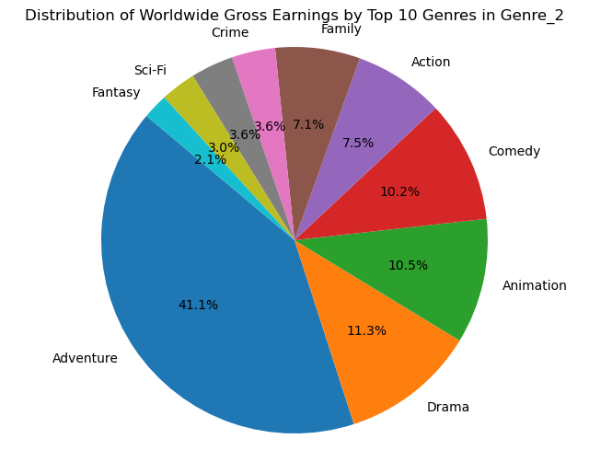
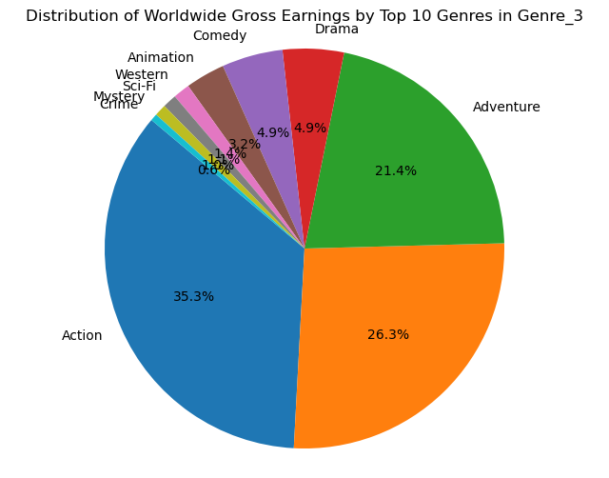
Which Genres have highest Worldwide Gross?

Slide 13
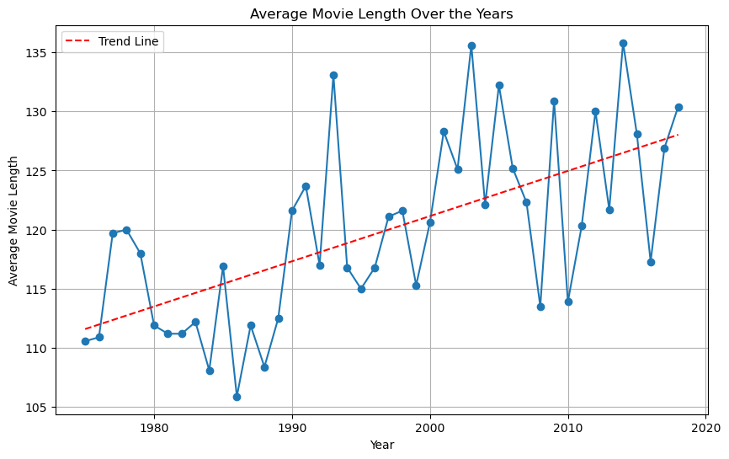
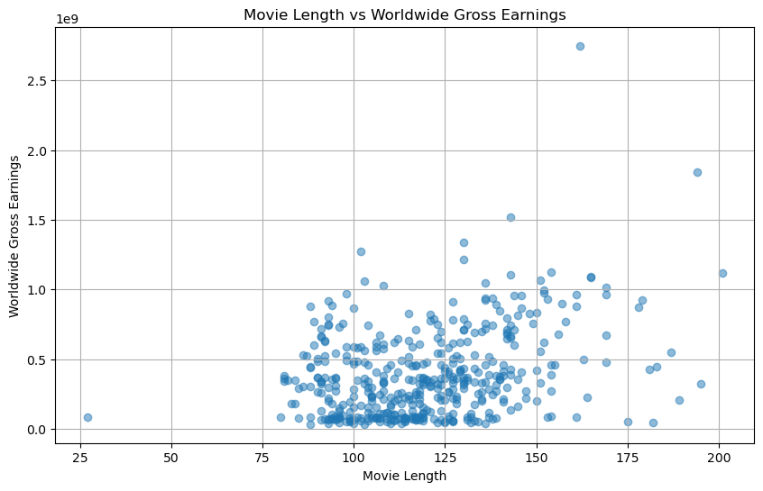
Does the Length of the movie Matter?

Slide 14
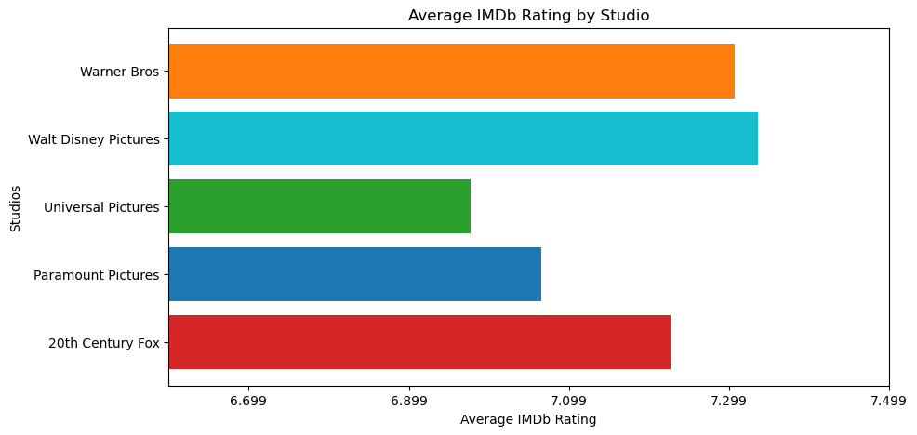
Does the rating of the movie Matter?
Test | Correlation | P-Value
Pearson’s R | 0.2882 | 2.0202 x 10⁻⁷
Spearman’s Rho | 0.2682 | 1.4143 x 10⁻⁶
Kendall’s Tau | 0.1864 | 1.2721 x 10⁻⁶
Notes:
Null Hypothesis: IMDb Rating has no effect on the Worldwide Gross

Slide 15
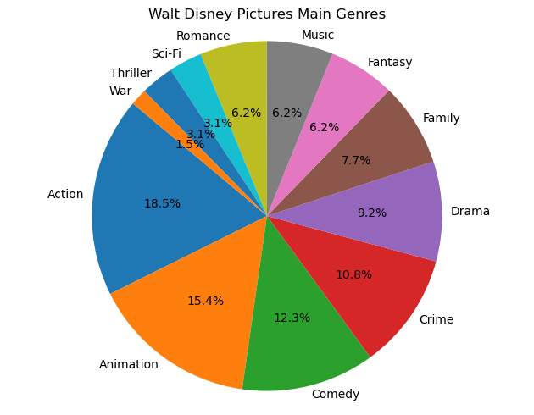
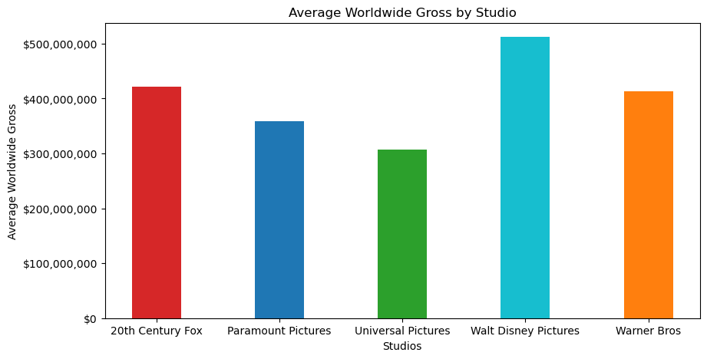
Which Studio should distribute the film?
Notes:
Walt Disney: Marvel

Slide 16
Which studios tend to earn the most money?
STUDIO | MEAN | MIN | MAX
20th Century Fox | $422m | $51m | $2,749m
Paramount Pictures | $359m | $53m | $1,843m
Universal Pictures | $308m | $35m | $971m
Walt Disney Studios | $512m | $37m | $1,519m
Warner Bros | $414m | $46m | $1,342m
Notes:
Comment on M&A within the industry

Slide 17
Decision
Major Motion Picture Investment

Slide 18

Our film characteristics
TYPE | Live Action
GENRES | Sci-Fi, Action, Adventure
RATING | PG-13
STUDIO | Walt Disney Pictures
LENGTH | 120-200

Slide 19
FINAL Comments & TAKEAWAYS
Major Motion Picture Investment

Slide 20
Additional Dataset Considerations
The dataset we used focuses on the annual Top 10 Worldwide Grossing movies:
By focusing on just the “winners” we might be introducing bias in the data
Further analysis should include all films, regardless of gross
Gross vs. Net Income
A better metric for an investment decision would be to also include budget and other expenses in the analysis
Worldwide Gross figures in the dataset are not inflation-adjusted:
Comparison of prior years is difficult
Incorporating additional attributes:
Release Date
Geographic Breakdown
Director / Actors
Additional statistical measurements

Slide 21

THANK YOU

